Slide 1

Solution Architecture Presentation
Spend Transaction Project
BY G1T5

Slide 2
Agenda
Introduction
Solution Design
Overall Cost
Product Demo
Maintainability Design and Implementation
Availability Design and Implementation
Security Design and Implementation
Performance Design and Implementation
Notes:
Guidelines to the Presentation Contents
Overall Solution Design and Development
Following are some guidelines to show your overall solution design.
Explain the project context, e.g., business needs, stakeholders, use cases, key qualities. Explain an overview of your solution design, e.g., network, deployment, layered diagrams, integration points.
Overall costs – as compared to your proposed costs. It can differ.
Maintainability Design and Implementation
Following are some guidelines to show your designs for maintainability. Demonstrate your designs to satisfy the following requirements.
Explain your development strategy, e.g., activity diagram.
Demonstrate the development process, e.g., make a change in the development environment, submit to GitHub, and trigger the necessary testing and delivery/deployment. Show the change on the client.
Demonstrate how ease of maintainability (e.g., design patterns, architectural styles, microservices, multitenancy) are achieved in your proposed architecture.
Highlight any key measures implemented specific to the context of your project.
Availability Design and Implementation
Following are some guidelines to show your designs for availability. Demonstrate your designs to satisfy the following requirements.
Show how the system is still available in the event of a server software process or hardware or network failures. For example, when one instance of the Tomcat software process or hardware/laptop hosting the Tomcat software process is not available, another instance can handle the request. At a minimum, one incident of server failure must be allowed. When the network connection between the proxy server and one instance of the hardware/laptop hosting the Tomcat process is not available, the client request is automatically routed to another instance to handle the request. At a minimum, one incident of such a network connection failure must be allowed.
Show how the session data of the user is still available when the failure occurs using session replication. For example, the session state (e.g., username) is replicated between the instances of the Tomcat instances so that the user does not need to log in again after the instance failover.
Show how session-affinity or sticky session works. If the first request is sent to one of the two instances of the Tomcat servers, subsequent requests should be sent to the same instance of the Tomcat server as the first request for the same session.
Other availability designs to reduce the single points of failure in your architecture will be considered.
SMU Classification: Restricted
2
•
- -
- -
-
•
- - - -
- -
Security Design and Implementation
Following are some guidelines to show your designs for security. Demonstrate your designs to satisfy the following requirements.
Ensure the application data are sent over an encrypted network tunnel.
Ensure proper access control between the components is configured within the network architecture. E.g., Tomcat instances must only be accessed by the proxy server. The databases should only be accessed by the Tomcat instances.
Show how the system is penetration tested using the OWASP Zap or a similar tool or an external accreditation site.
Identify and explain up to four key vulnerabilities of the architecture. For each of the vulnerability, demonstrate with codes or configuration or explanation by words/diagrams how the vulnerability can be addressed during the presentation.
Other security designs to reduce the attack surface in your architecture will be considered.
Performance Design and Implementation
Following are some guidelines to show your designs for performance. Demonstrate your designs to satisfy the following requirements.
Show how to implement a cache to improve the performance of your system.
Show how parallel execution can be done to improve the performance of your system. Show how pre-fetch can be done to improve the performance of your system.
For the above, you can explain using diagrams and/or a set of baseline and improved performance results.
Other performance designs to improve efficiency in your architecture will be considered. Highlight any key measures implemented specific to the context of your project.

Slide 3
Business Needs & Key Use Cases
Transactions
Point System
Campaign
Process from CSV files and from API calls
Process and store points accumulated by customers from different cards
Launch and handle campaigns in collaboration with merchants

Slide 4


Stakeholders
Customers
View points and transactions
Bank
Seamless transaction processing

Slide 5
Solution Design

Slide 6
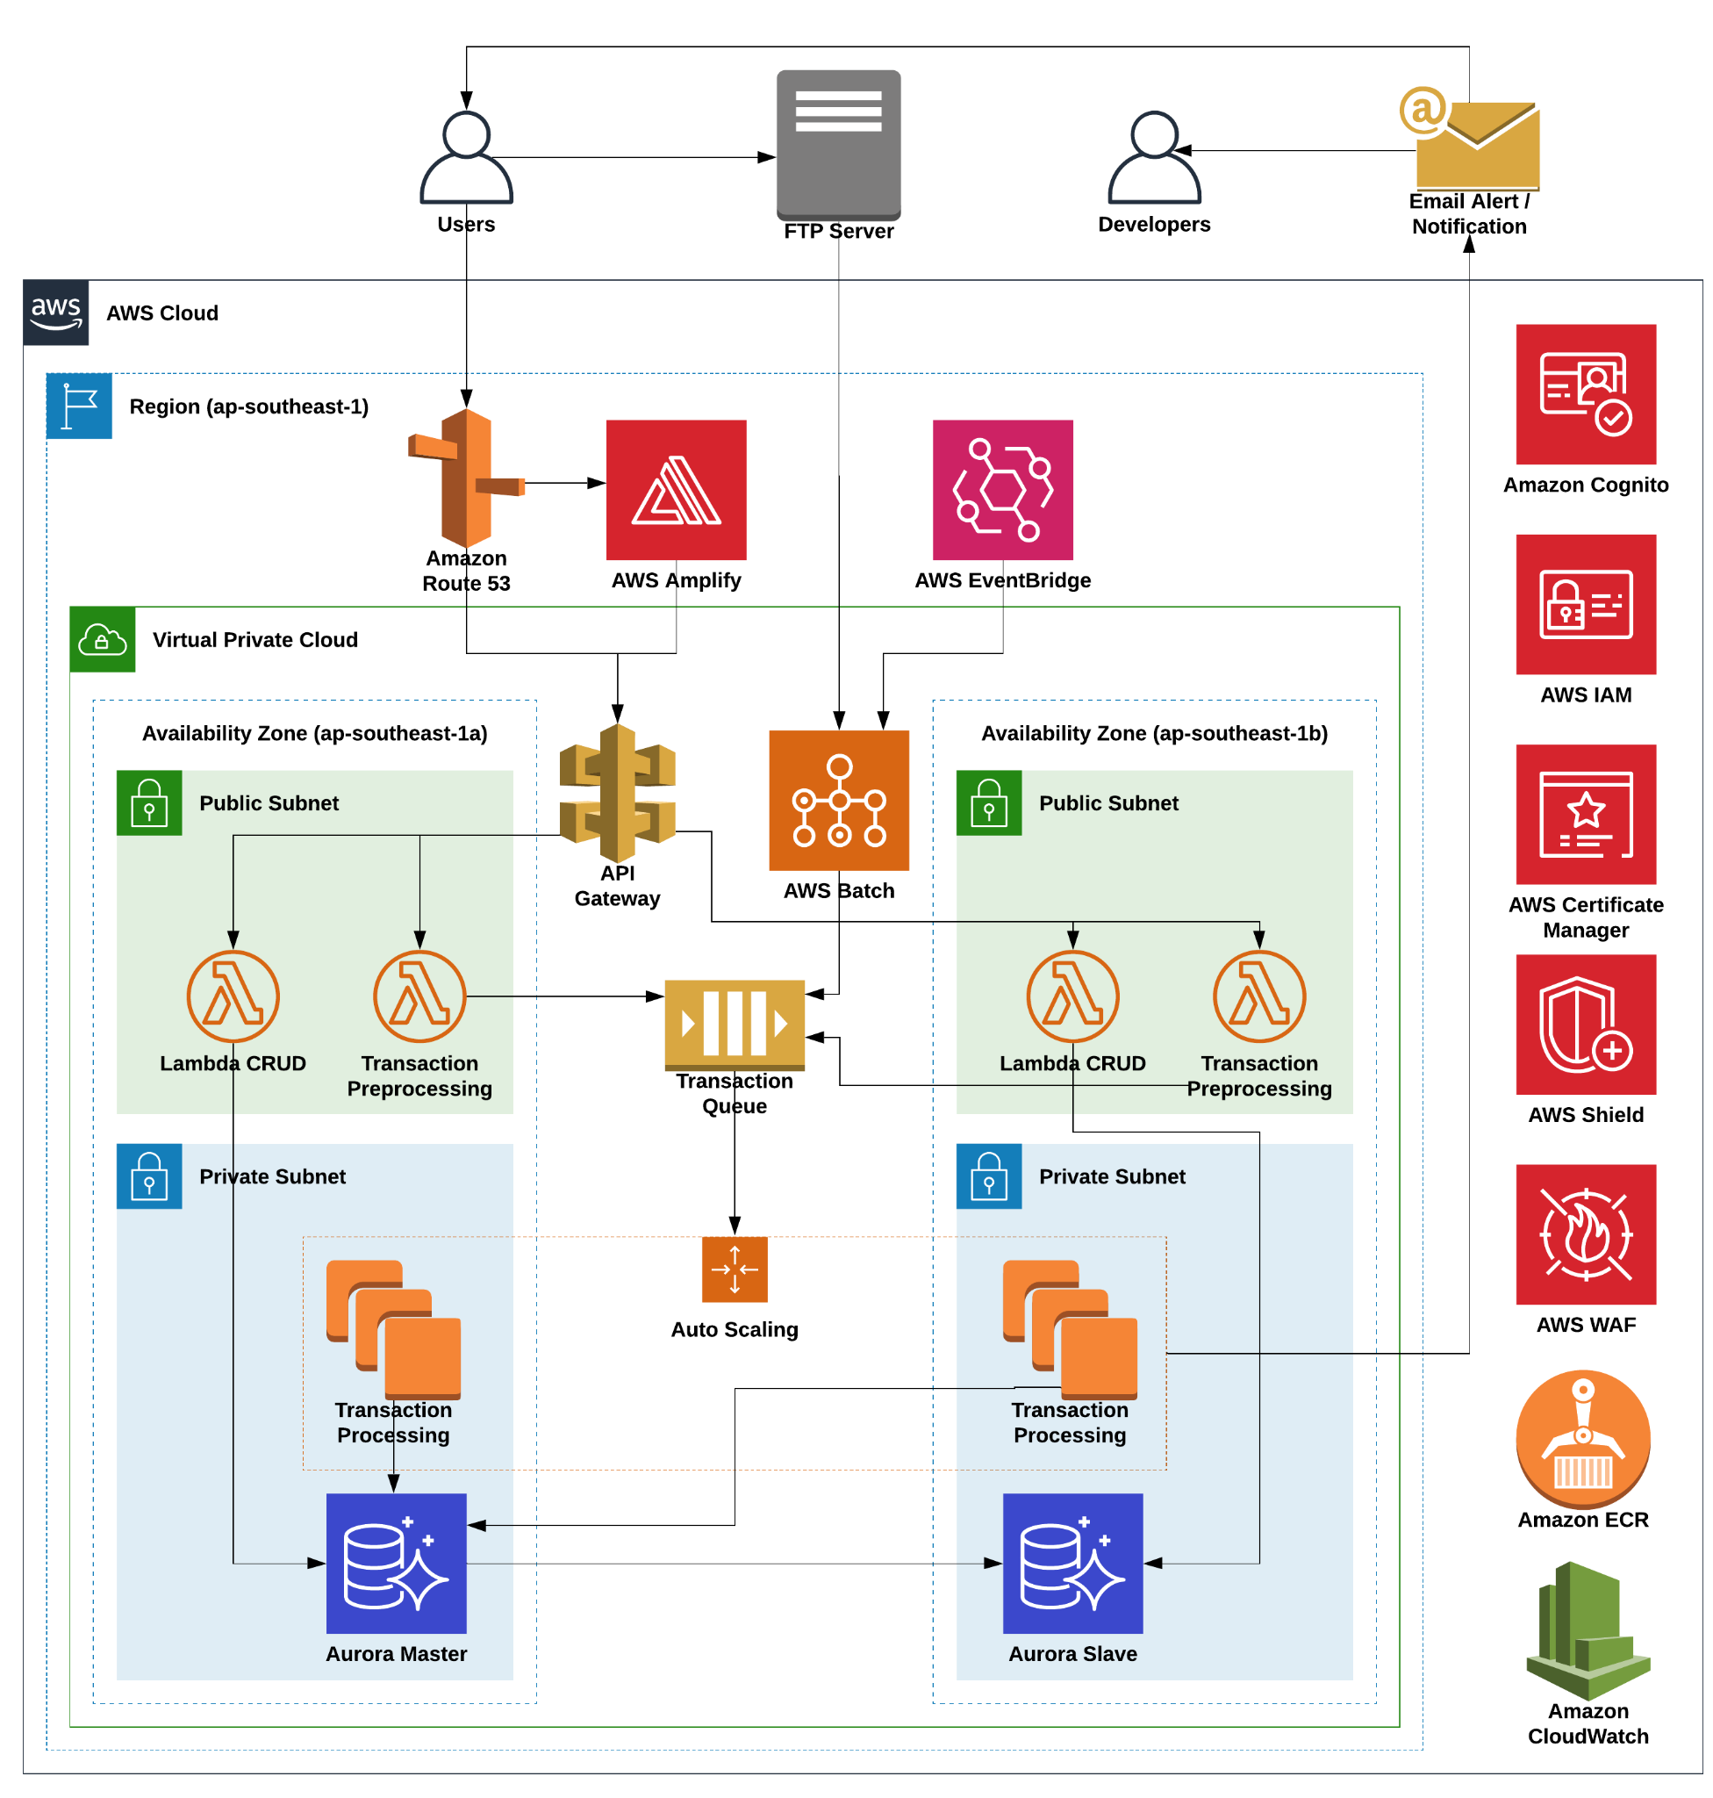

Slide 7
CSV Processing
Bank uploads transactions CSV file to FTP server daily
1
EventBridge cron event triggers Batch job to ingest CSV file
2
Batch job parses CSV file and adds each line into an SQS queue
3
Fargate instances in ASG process transactions and update database
4
Email notification for successful campaign applied is sent to user
5
Database replicates from master to slave asynchronously
6

Slide 8
CSV Processing
Bank uploads transactions CSV file to FTP server daily
1
EventBridge cron event triggers Batch job to ingest CSV file
2
Batch job parses CSV file and adds each line into an SQS queue
3
Fargate instances in ASG process transactions and update database
4
Email notification for successful campaign applied is sent to user
5
Database replicates from master to slave asynchronously
6

Slide 9
CSV Processing
Bank uploads transactions CSV file to FTP server daily
1
EventBridge cron event triggers Batch job to ingest CSV file
2
Batch job parses CSV file and adds each line into an SQS queue
3
Fargate instances in ASG process transactions and update database
4
Email notification for successful campaign applied is sent to user
5
Database replicates from master to slave asynchronously
6

Slide 10
CSV Processing
Bank uploads transactions CSV file to FTP server daily
1
EventBridge cron event triggers Batch job to ingest CSV file
2
Batch job parses CSV file and adds each line into an SQS queue
3
Fargate instances in ASG process transactions and update database
4
Email notification for successful campaign applied is sent to user
5
Database replicates from master to slave asynchronously
6
Notes:
Actually nothing changed?

Slide 11
CSV Processing
Bank uploads transactions CSV file to FTP server daily
1
EventBridge cron event triggers Batch job to ingest CSV file
2
Batch job parses CSV file and adds each line into an SQS queue
3
Fargate instances in ASG process transactions and update database
4
Email notification for successful campaign applied is sent to user
5
Database replicates from master to slave asynchronously
6

Slide 12
CSV Processing
Bank uploads transactions CSV file to FTP server daily
1
EventBridge cron event triggers Batch job to ingest CSV file
2
Batch job parses CSV file and adds each line into an SQS queue
3
Fargate instances in ASG process transactions and update database
4
Email notification for successful campaign applied is sent to user
5
Database replicates from master to slave asynchronously
6
Notes:
Actually nothing changed?

Slide 13
CSV Processing
Bank uploads transactions CSV file to FTP server daily
1
EventBridge cron event triggers Batch job to ingest CSV file
2
Batch job parses CSV file and adds each line into an SQS queue
3
Fargate instances in ASG process transactions and update database
4
Email notification for successful campaign applied is sent to user
5
Database replicates from master to slave asynchronously
6

Slide 14
API Processing
Bank posts individual transactions to custom domain on Route 53
1
Route 53 routes the request to endpoint on API Gateway
2
API Gateway calls lambda to process and enqueue transaction
3
Fargate instances in ASG process transaction and update database
4
Email notification for successful campaign applied is sent to user
5
Database replicates from master to slave asynchronously
6

Slide 15
API Processing
Bank posts individual transactions to custom domain on Route 53
1
Route 53 routes the request to endpoint on API Gateway
2
API Gateway calls lambda to process and enqueue transaction
3
Fargate instances in ASG process transaction and update database
4
Email notification for successful campaign applied is sent to user
5
Database replicates from master to slave asynchronously
6

Slide 16
API Processing
Bank posts individual transactions to custom domain on Route 53
1
Route 53 routes the request to endpoint on API Gateway
2
API Gateway calls lambda to process and enqueue transaction
3
Fargate instances in ASG process transaction and update database
4
Email notification for successful campaign applied is sent to user
5
Database replicates from master to slave asynchronously
6

Slide 17
API Processing
Bank posts individual transactions to custom domain on Route 53
1
Route 53 routes the request to endpoint on API Gateway
2
API Gateway calls lambda to process and enqueue transaction
3
Fargate instances in ASG process transaction and update database
4
Email notification for successful campaign applied is sent to user
5
Database replicates from master to slave asynchronously
6

Slide 18
API Processing
Bank posts individual transactions to custom domain on Route 53
1
Route 53 routes the request to endpoint on API Gateway
2
API Gateway calls lambda to process and enqueue transaction
3
Fargate instances in ASG process transaction and update database
4
Email notification for successful campaign applied is sent to user
5
Database replicates from master to slave asynchronously
6

Slide 19
API Processing
Bank posts individual transactions to custom domain on Route 53
1
Route 53 routes the request to endpoint on API Gateway
2
API Gateway calls lambda to process and enqueue transaction
3
Fargate instances in ASG process transaction and update database
4
Email notification for successful campaign applied is sent to user
5
Database replicates from master to slave asynchronously
6

Slide 20
API Processing
Bank posts individual transactions to custom domain on Route 53
1
Route 53 routes the request to endpoint on API Gateway
2
API Gateway calls lambda to process and enqueue transaction
3
Fargate instances in ASG process transaction and update database
4
Email notification for successful campaign applied is sent to user
5
Database replicates from master to slave asynchronously
6

Slide 21
Frontend
User visits website via custom domain on Route 53
1
Route 53 routes the traffic to CloudFront distribution on Amplify
2
User logs in to frontend via Cognito
3
Frontend calls endpoints on API Gateway to populate data
4
API gateway calls Lambda to read information from database
5
Data is cached on the user’s browser for improved performance
6

Slide 22
Frontend
User visits website via custom domain on Route 53
1
Route 53 routes the traffic to CloudFront distribution on Amplify
2
User logs in to frontend via Cognito
3
Frontend calls endpoints on API Gateway to populate data
4
API gateway calls Lambda to read information from database
5
Data is cached on the user’s browser for improved performance
6

Slide 23
Frontend
User visits website via custom domain on Route 53
1
Route 53 routes the traffic to CloudFront distribution on Amplify
2
User logs in to frontend via Cognito
3
Frontend calls endpoints on API Gateway to populate data
4
API gateway calls Lambda to read information from database
5
Data is cached on the user’s browser for improved performance
6

Slide 24
Frontend
User visits website via custom domain on Route 53
1
Route 53 routes the traffic to CloudFront distribution on Amplify
2
User logs in to frontend via Cognito
3
Frontend calls endpoints on API Gateway to populate data
4
API gateway calls Lambda to read information from database
5
Data is cached on the user’s browser for improved performance
6

Slide 25
Frontend
User visits website via custom domain on Route 53
1
Route 53 routes the traffic to CloudFront distribution on Amplify
2
User logs in to frontend via Cognito
3
Frontend calls endpoints on API Gateway to populate data
4
API gateway calls Lambda to read information from database
5
Data is cached on the user’s browser for improved performance
6

Slide 26
Frontend
User visits website via custom domain on Route 53
1
Route 53 routes the traffic to CloudFront distribution on Amplify
2
User logs in to frontend via Cognito
3
Frontend calls endpoints on API Gateway to populate data
4
API gateway calls Lambda to read information from database
5
Data is cached on the user’s browser for improved performance
6

Slide 27
Frontend
User visits website via custom domain on Route 53
1
Route 53 routes the traffic to CloudFront distribution on Amplify
2
User logs in to frontend via Cognito
3
Frontend calls endpoints on API Gateway to populate data
4
API gateway calls Lambda to read information from database
5
Data is cached on the user’s browser for improved performance
6

Slide 28
Frontend
User visits website via custom domain on Route 53
1
Route 53 routes the traffic to CloudFront distribution on Amplify
2
User logs in to frontend via Cognito
3
Frontend calls endpoints on API Gateway to populate data
4
API gateway calls Lambda to read information from database
5
Data is cached on the user’s browser for improved performance
6

Slide 29
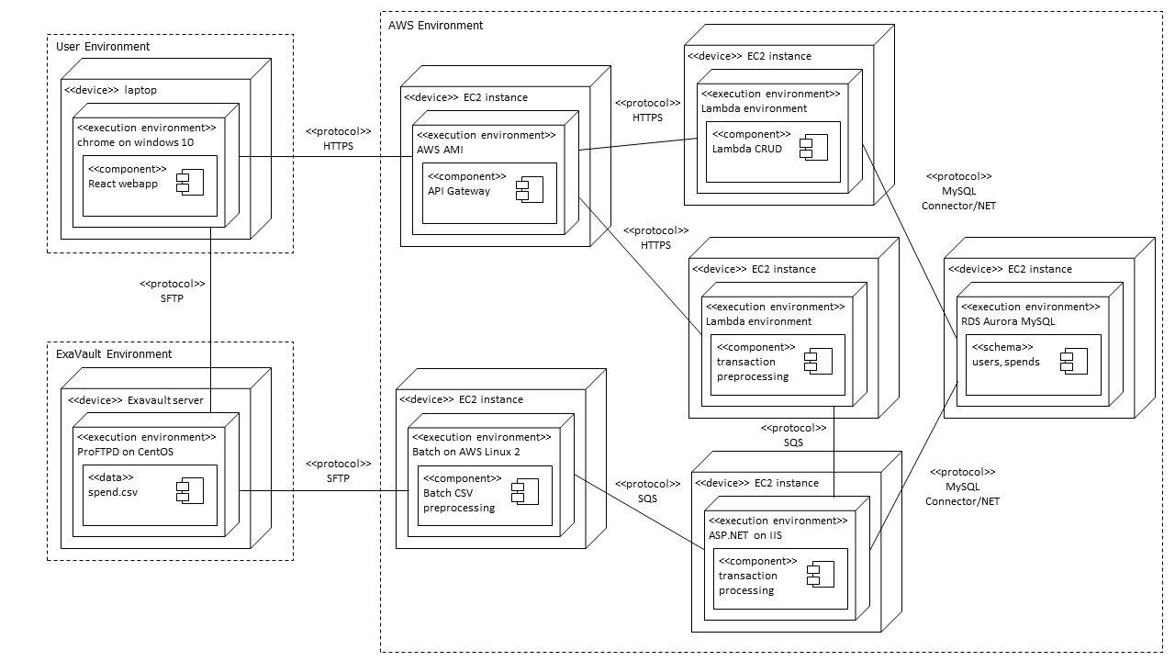

Slide 30
Cost

Slide 31
Development
Activity/ Hardware/Software/ Service | Description | Estimated Cost
Developing code, tests and documentation | Total cost to develop and test services for the product | 5 * 30 man-hours/person = 150 man-hours
Continuous integration and deployment - AWS CodePipeline | Costs associated with building, integrating and deploying code | $200 (AWS credits)
Cloud services for development and staging environment | Costs associated with experimental cloud services used for development

Slide 32
Production
Activity/ Hardware/Software/ Service | Description | Budgeted Cost | Actual Average Monthly Cost
Compute - EC2, Batch | VMs | $142.80 | $8.40
Compute - ECS | Run transaction processing |  | $69.20
Compute - Lambda | Serverless compute | $28.37 | $28.37
Storage - Aurora | Databases, replication etc | $249.64 | $249.64
Queue - SQS | Message queue service | $12 | $12.00
Misc - API gateway, Cloudwatch, Cognito, ECR, S3, GuardDuty, Amplify, SES | Additional miscellaneous services | $13.10 | >$2.00
Maintenance | Code revisions and changes |  | 5 man hours

Slide 33
Product Demo

Slide 34
Maintainability

Slide 35
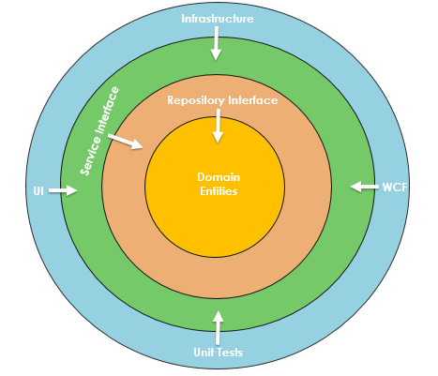
Backend
Onion Architecture
Layers:
Service
Repository
Domain
Aim:
Separation of concerns, dependency hierarchy, improved maintainability
Notes:
For code maintainability, we adopted the Onion Architecture when building the .NET application. This reduces unnecessary coupling and improves our maintainability,
Centre of the architecture is domain, representing the business and behaviour objects.
Then we have repository layer, this usually houses the abstraction of saving and retrieving behaviour involving database
Then we have service layer, holding the business logic for our application.
Since coupling is towards centre and build on top of the inner layers, whatever changes outside will not affect anything in the centre.

Slide 36
Exclusions, programs, campaigns
Exclusions
Apply to card type and MCC
First check, if an exclusion is found, no further rules processed
Programs
Default reward scheme for card types
Special clauses for certain MCCs (e.g. shopping, hotels, online shopping)
Campaigns
Short-term reward schemes for card types and merchants
Processed independently and can be stacked
Filter exclusions
Apply fixed rewards
Apply variable rewards

Slide 37
DevOps principles
Infrastructure as code
CloudFormation templates for networking (VPC) and database (AWS Aurora)
Serverless deployments using declarative templates
CI/CD pipelines
Automated docker build, tag and push for container services
Serverless deploy command
Push to frontend triggers amplify deployments
Loose coupling of services
Separate scope of responsibilities
Services can be independently modified without changing overall application behaviour

Slide 38
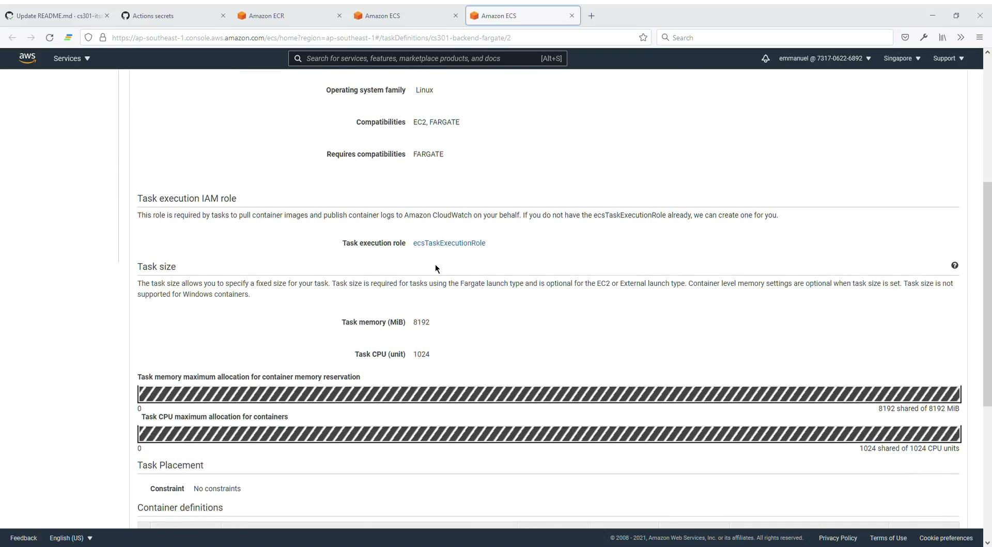
GitHub Actions Demo
Notes:
Video link is accessible at https://drive.google.com/file/d/1KkoGf8_wyd6pwkpyTMJQl4uOuJcCkP_L/view?usp=sharing

Slide 39
Availability

Slide 40
Availability View
Node | Redundancy | Clustering |  |  | Replication (if applicable)
 |  | Node Config. | Failure Detection | Failover | Repl. Type | Session State Storage | DB Repl. Config. | Repl. Mode
Batch | Vertical | Single node | Health check | Job restarted | NA
Aurora | Horizontal | Active-Active | Ping | Update cluster endpoint | DB | NIL | Master- Slave | Asynchronous
ECS | Horizontal | Active-Active | Health check | ASG replaced/Task restarted | NA

Slide 41
Security

Slide 42
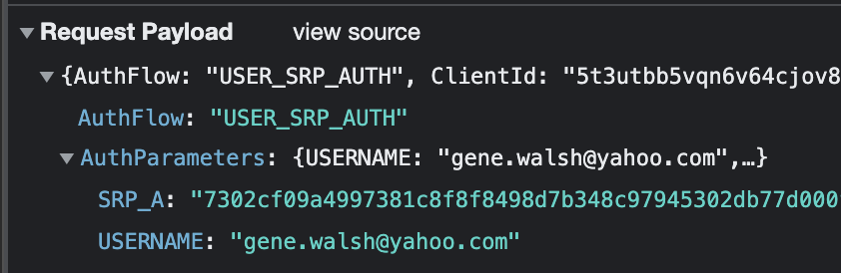
Possible Threat - MITM Attack
TLS
All requests to regarding user credentials are made over TLS
Secure Remote Password Protocol
All passwords are are never revealed during transit or rest
Whitelisting
Only hosts that are whitelisted are allowed to send requests using our API endpoints

Slide 43
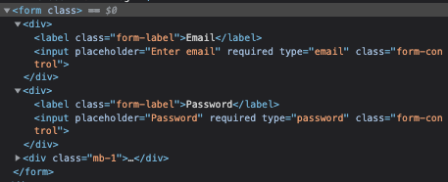
Possible Threats - SQL Injection
User input sanitisation
Validate that user email and password are legitimate and in the right format before sending the request
Obfuscation of password
Admins are only allowed to set user’s initial password login. Users will have to reset their password on the subsequent logins
Object Relational Mapping tools
We use tools like Entity Framework on .Net and Sequelize on Node.js. They use parameterised SQL statements to query the database

Slide 44
Possible Threats - DDoS Attacks
AWS Web Application Firewall
Monitors incoming HTTP and HTTPS requests to check for any malicious attempts.
AWS Shield
Automatically baselines traffic, identifies anomalies and creates mitigations when necessary.

Slide 45
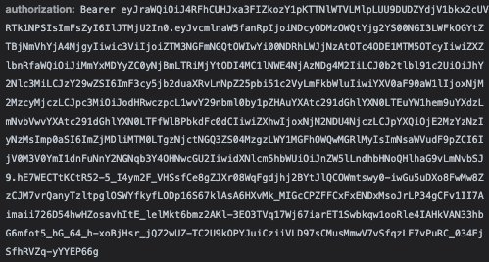
Possible Threats - User Impersonation
AWS Cognito User Pool
Cognito provides us with industrial standard user pool management capabilities , handling authentication, authorisation and user management
JWT Token Authorization
JWT token issued by AWS Cognito complies with the OAuth2 standard

Slide 46
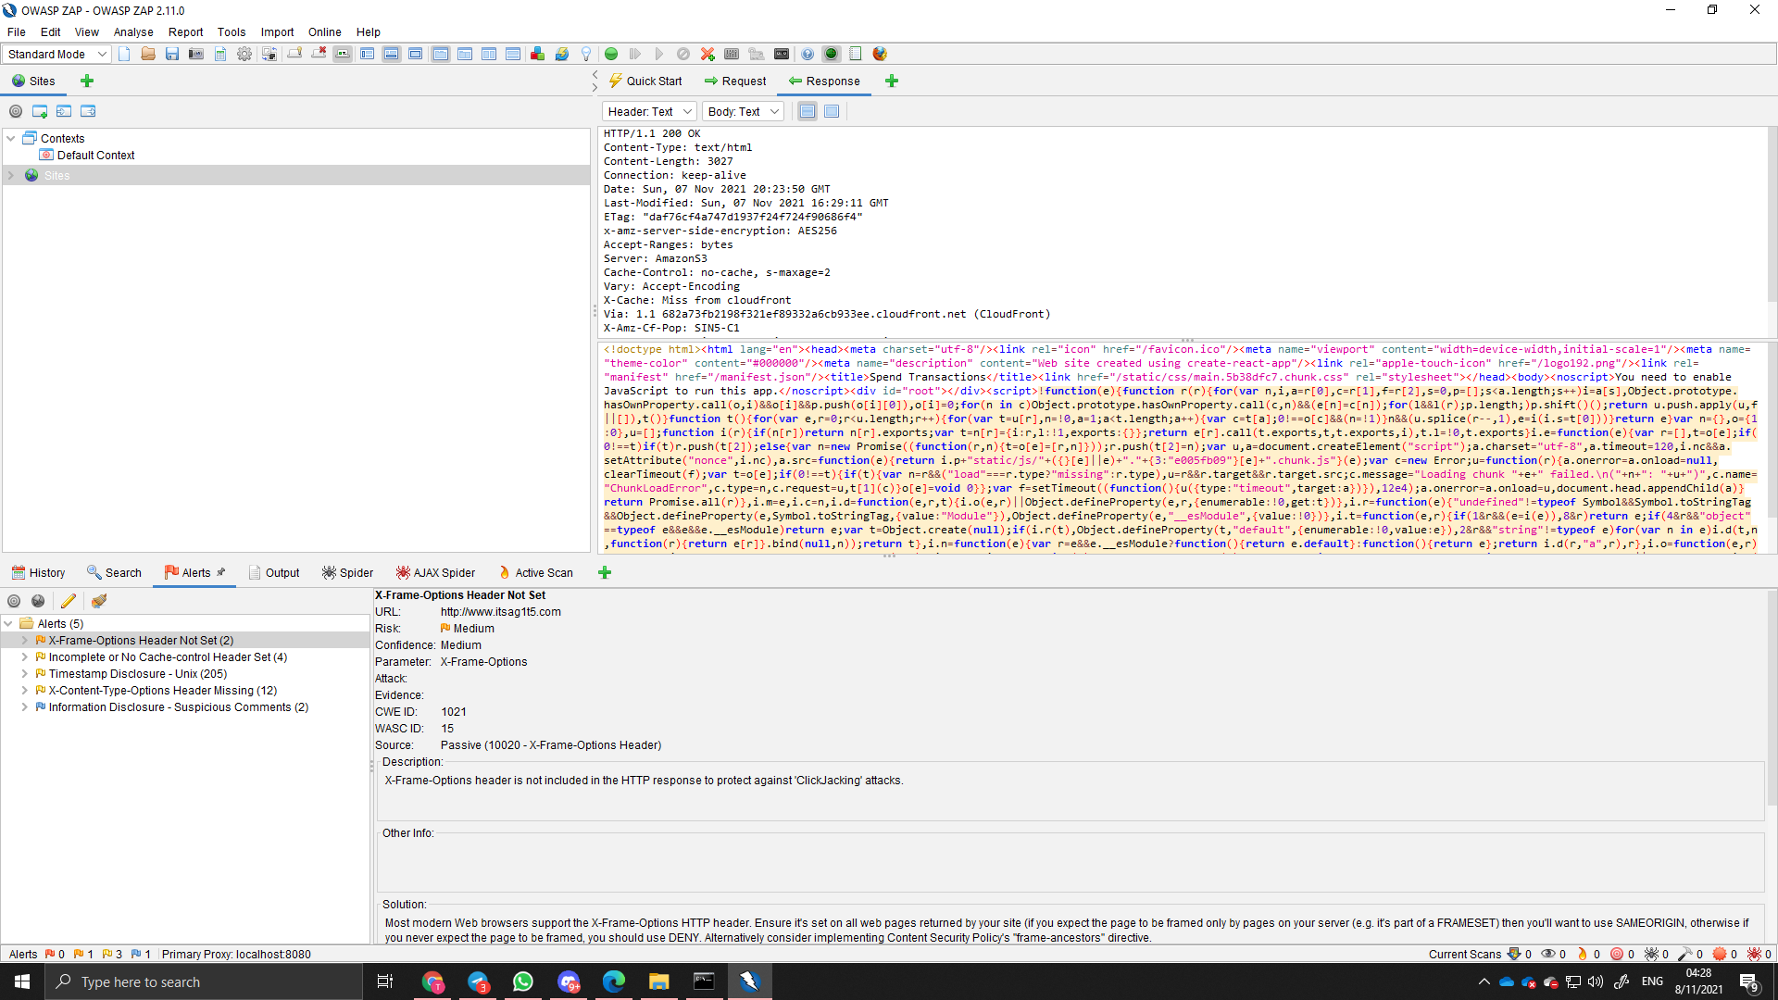
OWASP ZAP Penetration testing result

Slide 47
Penetration testing results
X-Frame-Options Header not set
Mitigations: Set X-Frame-Options to DENY as we do not expect any of our content to be embedded
X-Content-Type-Options Header missing
Mitigations: Set X-Content-Type-Options to nosniff

Slide 48
Performance

Slide 49
Architecture
Edge Optimisation
Provider-managed scaling
Read Replicas
Compute, networking and storage infrastructure are launched in regions where services are used the most frequently
Making use of managed AWS services which facilitate scaling in and out in response to changes in workload
AWS batch
ECS Fargate Clusters
Aurora RDS
Read replicas for retrieving transactions and points data by Lambda to offload the workload on the write database

Slide 50
Backend
Asynchronous and Parallel Programming
Database Denormalization
.NET performance best practices
Used Asynchronous Queries whenever possible
.NET’s Parallel ForEach Loop
Denormalized tables that are READ heavy, for example Rules, which includes Programs and Campaigns to increase READ speed
Minimize network round trips
Filter and Aggregate queries to reduce server load
Use of Singleton and Transient patterns
Notes:
Local machine to local database performance benchmark on a M1 Macbook (16GB RAM)
Without Parallezation: 100 messages consumed and inserted in 64000ms
With Parallezation and Asynchronous programming: 1080 messages consumed and inserted in 60000ms
.NET performance best practices
Minimize network round trips by committing data inserts only when needed (SaveChangesAsync)
Batch querying from SQS (maximum 10) instead of querying 1 by 1, actually most of the latency is due to SQS query
Filter and Aggregating queries using LINQ Where clause let database handle filtering to offload the server
For Services like Database Service, Singleton pattern is used
For Services like Transaction Service, Transient is used as Singleton will cause memory leak to build up. Since there is no need to maintain state between each transaction processing, Scoped lifetime is not used.
Database Denormalization
Denormalized tables like Programs and Campaigns into one Rules table in MySQL since it is READ heavy to improve READ performance
Normalize tables that are INSERTed frequently like transactions and points

Slide 51
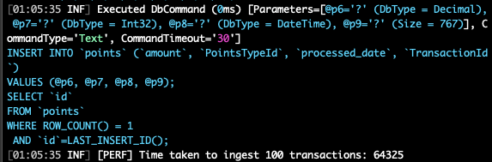
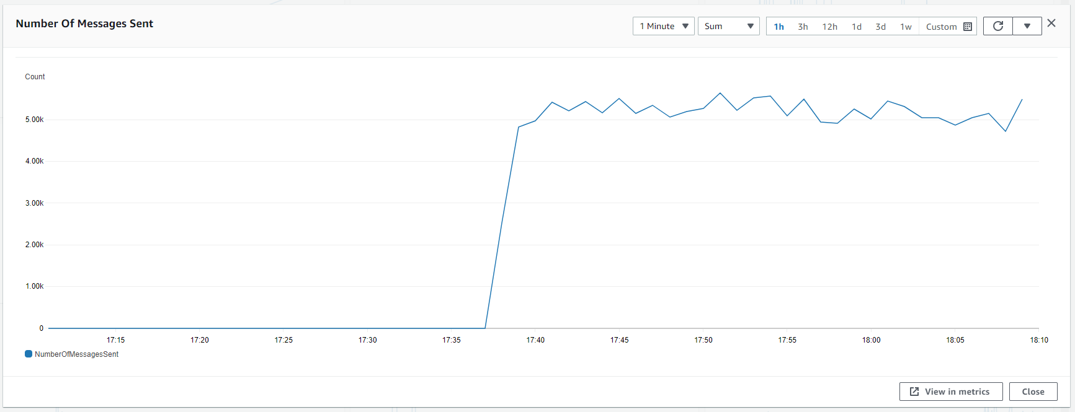
Backend
Before parallelization
After parallelization
On Fargate
Notes:
Local machine to local database performance benchmark on a M1 Macbook (16GB RAM)
Without Parallelization: 100 messages consumed and inserted in 64000ms
With Parallelization and Asynchronous programming: 1080 messages consumed and inserted in 60000ms
.NET performance best practices
Minimize network round trips by committing data inserts only when needed (SaveChangesAsync)
Batch querying from SQS (maximum 10) instead of querying 1 by 1, actually most of the latency is due to SQS query
Filter and Aggregating queries using LINQ Where clause let database handle filtering to offload the server
For Services like Database Service and Transaction Services (TBD), Singleton pattern is used
Database Denormalization
Denormalized tables like Programs and Campaigns into one Rules table in MySQL since it is READ heavy to improve READ performance
Normalize tables that are INSERTed frequently like transactions and points

Slide 52
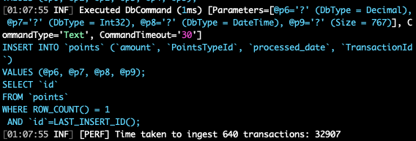
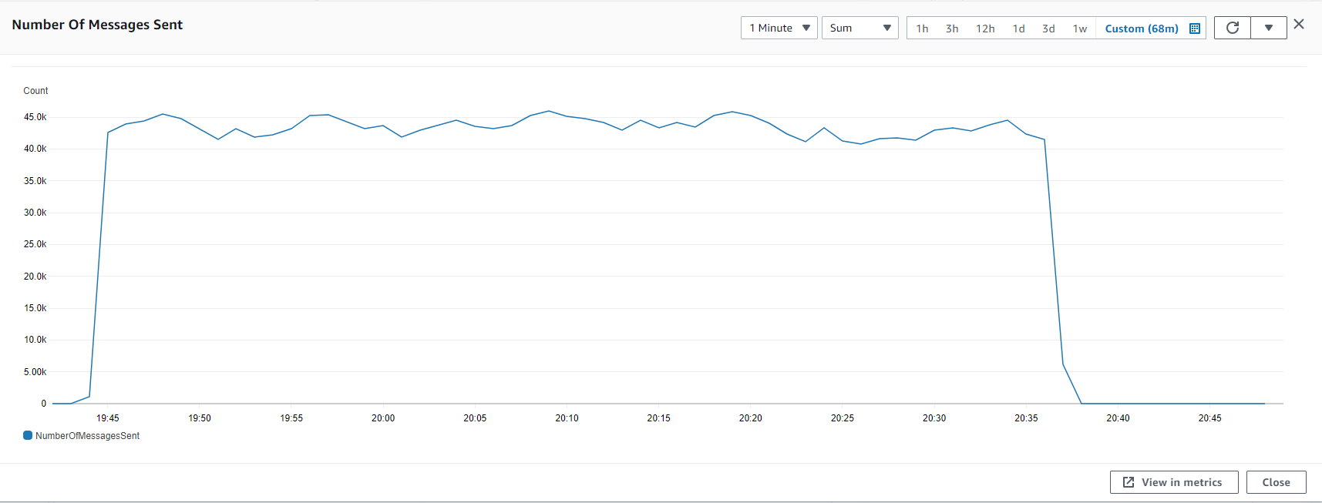
Backend
Before parallelization
After parallelization
On Fargate
Notes:
Local machine to local database performance benchmark on a M1 Macbook (16GB RAM)
Without Parallezation: 100 messages consumed and inserted in 64000ms
With Parallezation and Asynchronous programming: 1080 messages consumed and inserted in 60000ms
.NET performance best practices
Minimize network round trips by committing data inserts only when needed (SaveChangesAsync)
Batch querying from SQS (maximum 10) instead of querying 1 by 1, actually most of the latency is due to SQS query
Filter and Aggregating queries using LINQ Where clause let database handle filtering to offload the server
For Services like Database Service, Singleton pattern is used
For Services like Transaction Service, Transient is used as Singleton will cause memory leak to build up. Since there is no need to maintain state between each transaction processing, Scoped lifetime is not used.
Database Denormalization
Denormalized tables like Programs and Campaigns into one Rules table in MySQL since it is READ heavy to improve READ performance
Normalize tables that are INSERTed frequently like transactions and points

Slide 53
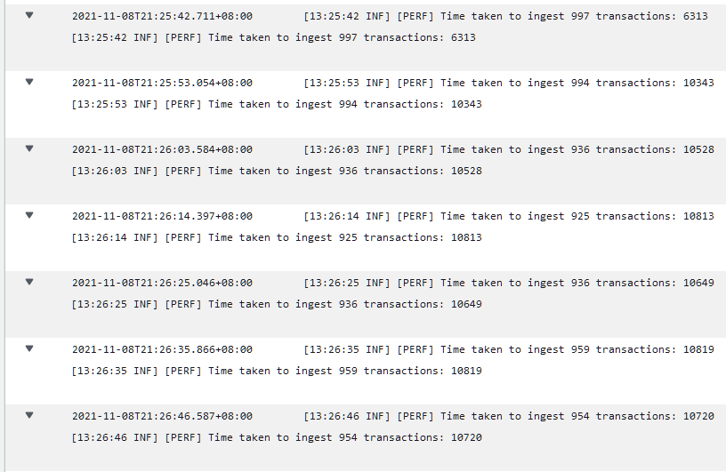
Backend
Before parallelization
After parallelization
On Fargate
Notes:
Local machine to local database performance benchmark on a M1 Macbook (16GB RAM)
Without Parallezation: 100 messages consumed and inserted in 64000ms
With Parallezation and Asynchronous programming: 1080 messages consumed and inserted in 60000ms
.NET performance best practices
Minimize network round trips by committing data inserts only when needed (SaveChangesAsync)
Batch querying from SQS (maximum 10) instead of querying 1 by 1, actually most of the latency is due to SQS query
Filter and Aggregating queries using LINQ Where clause let database handle filtering to offload the server
For Services like Database Service and Transaction Services (TBD), Singleton pattern is used
Database Denormalization
Denormalized tables like Programs and Campaigns into one Rules table in MySQL since it is READ heavy to improve READ performance
Normalize tables that are INSERTed frequently like transactions and points

Slide 54
Frontend
Cache Transaction Data
Reduce bundle size
Search & Pagination Optimization
Use total points to check if cached transaction data is updated. If the points matches, retrieve the data from cache. Else retrieve from backend.
Optimize assets and use tree shaking to eliminate dead code
Reduced 100kb of bundle size
Implement debounce and throttle to prevent the user from invoking the search and pagination functions too frequently.

Slide 55

Thank You!
Any Questions?

Slide 56
Credits
Assets from Icon8, Figma Community, FlatIcon, and SlidesMania

